Slide 1
Jane Austen’s Lady Susan: Visualizing Data as Network Graphs
Alexandra Bolintineanu

Slide 2
Modelling Data as Network
Network Graph:
Things: nodes (vertices)
Relationships: edges
Network

Slide 3
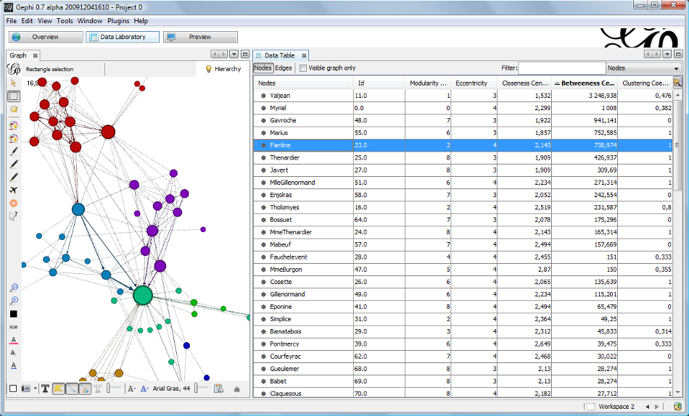
Les Miserables: Network Graph of Character Interactions
Network graph from Gephi (http://gephi.github.io/images/screenshots/datatable.png). See also Gephi Datasets (https://wiki.gephi.org/index.php/Datasets): “Coappearance weighted network of characters in the novel Les Miserables.” D. E. Knuth, The Stanford GraphBase: A Platform for Combinatorial Computing, Addison-Wesley, Reading, MA (1993).

Slide 4
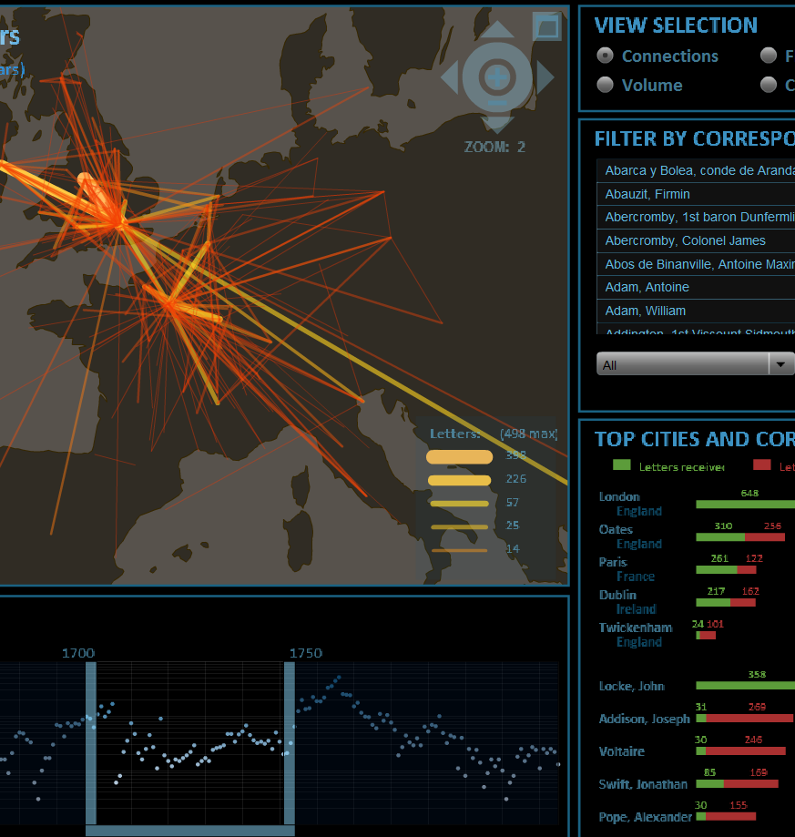
Mapping the Republic of Letters
Stanford University’s Mapping the Republic of Letters (http://republicofletters.stanford.edu/; for network graph, see http://web.stanford.edu/group/toolingup/rplviz/) visualizes networks of correspondence among Enlightenment-era writers and intellectuals.

Slide 5
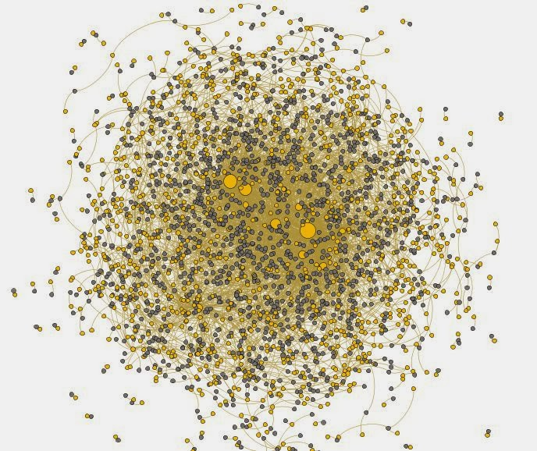
Networks of Medieval Manuscript Ownership
Mitch Fraas, “Charting Former Owners of Penn's Codex Manuscripts,” Mapping Books (http://mappingbooks.blogspot.ca/2014/01/), January 24, 2014.

Slide 6
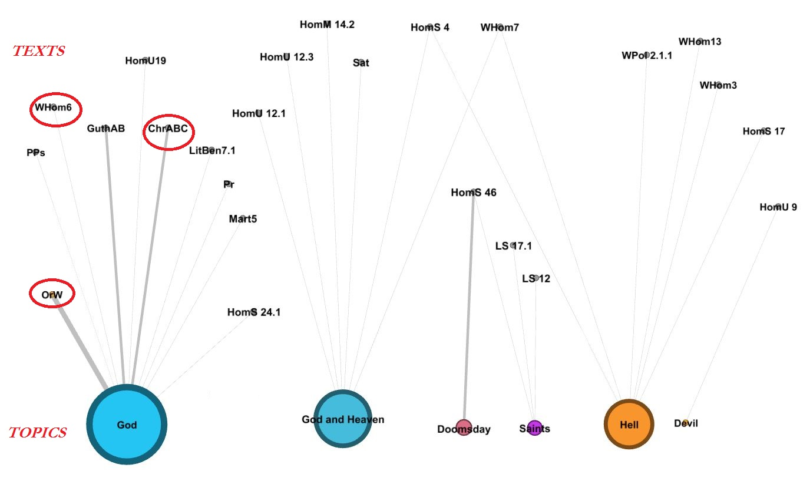
Old English Declarations of Unknowing
A. Bolintineanu, “Beyond the Sun’s Setting: Declarations of Unknowing in Old English.”

Slide 7
Modelling Jane Austen’s Lady Susan Data as Network
Network Graph:
Things: nodes (vertices)
= correspondents
Relationships: edges
= letters
Senders:
letters
Recipients:

Slide 8
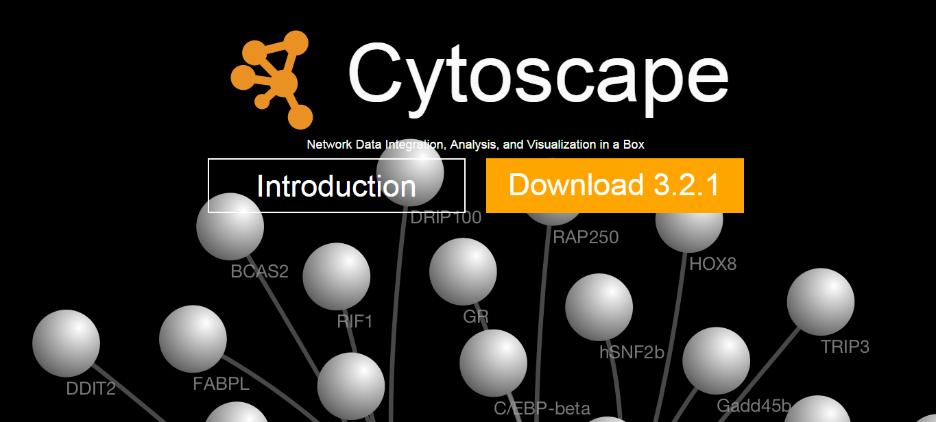
Cytoscape
Free, open-source visualization software platform
Complex networks across disciplines
Originated in bioinformatics

Slide 9
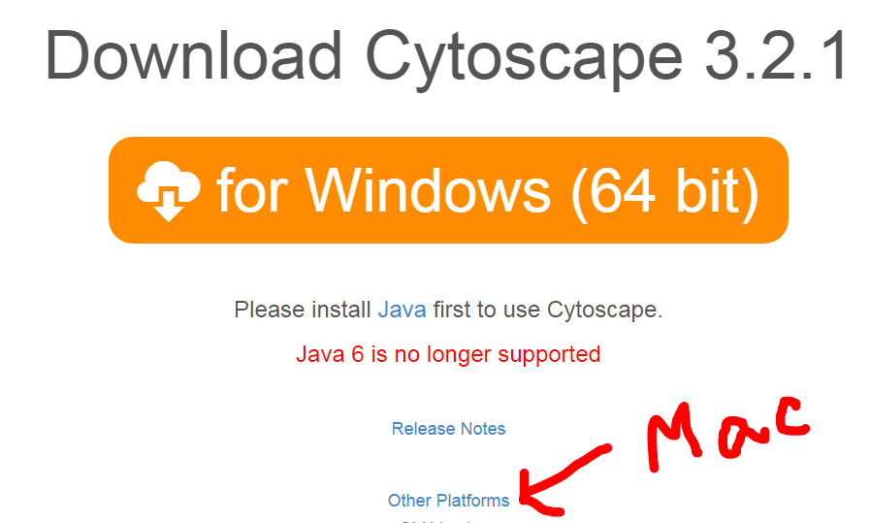
Make the Graph
Download and install Cytoscape following the software’s instructions.
(You may have to install Java first. All links are provided on the Cytoscape site: cytoscape.org)

Slide 10
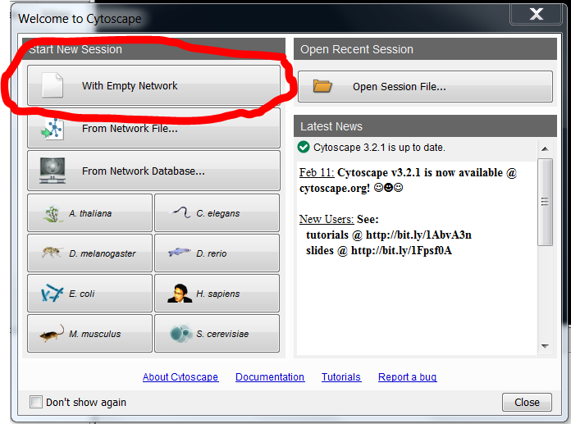
Make the Graph
Open Cytoscape
On the small screen that pops up, select “Start New session With Empty Network”

Slide 11
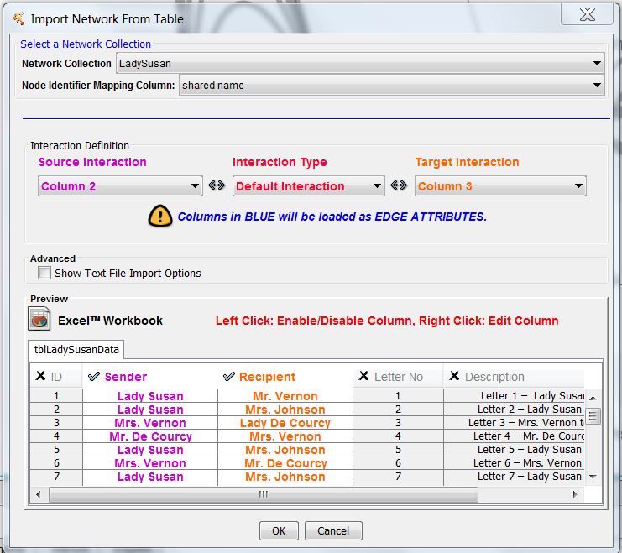
Make the Graph
File → Import → Network → File
Select your Excel file: tblLadySusanData.xls
Remember, characters (i.e. letter senders and recipients) are your nodes (points on the graph); letters are the edges (lines between them).
Go to Interaction Definition and enter settings accordingly::
Source Interaction: Column 2, the senders
Interaction Type: Default interaction
Target: Column 3, the recipients
(disable other columns in table below)

Slide 12
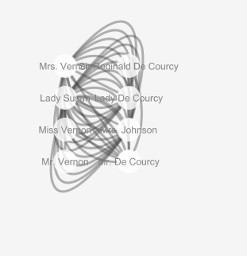
View the Graph
The resulting graph:

Slide 13
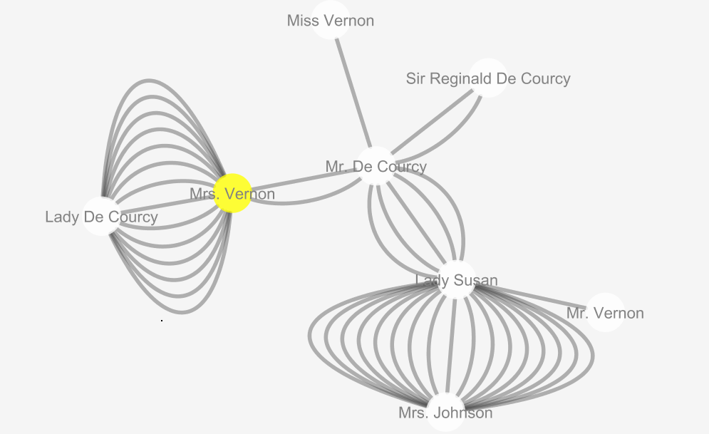
Edit the Graph
Make the graph clearer:
Click on a node until it turns yellow and drag it about to reposition it
Layout → Apply Preferred Layout

Slide 14
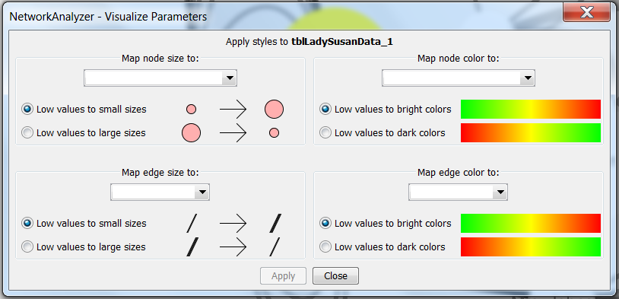
Edit the Graph
Make quantitative relationships visible:
Tools → Network Analyzer → Network Analysis → Generate Style from Statistics
Say yes
Treat Graph as Directed

Slide 15
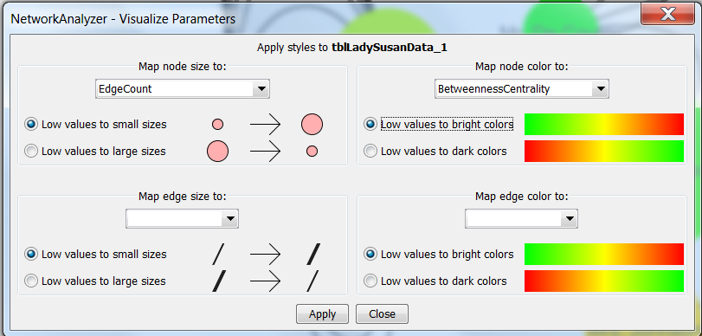
Edge Count: # of edges from and to this node

Slide 16
Network Characteristics
Outdegree = # of edges out of this node
Indegree = # of edges into this node
Centrality:
https://en.wikipedia.org/wiki/Centrality

Slide 17
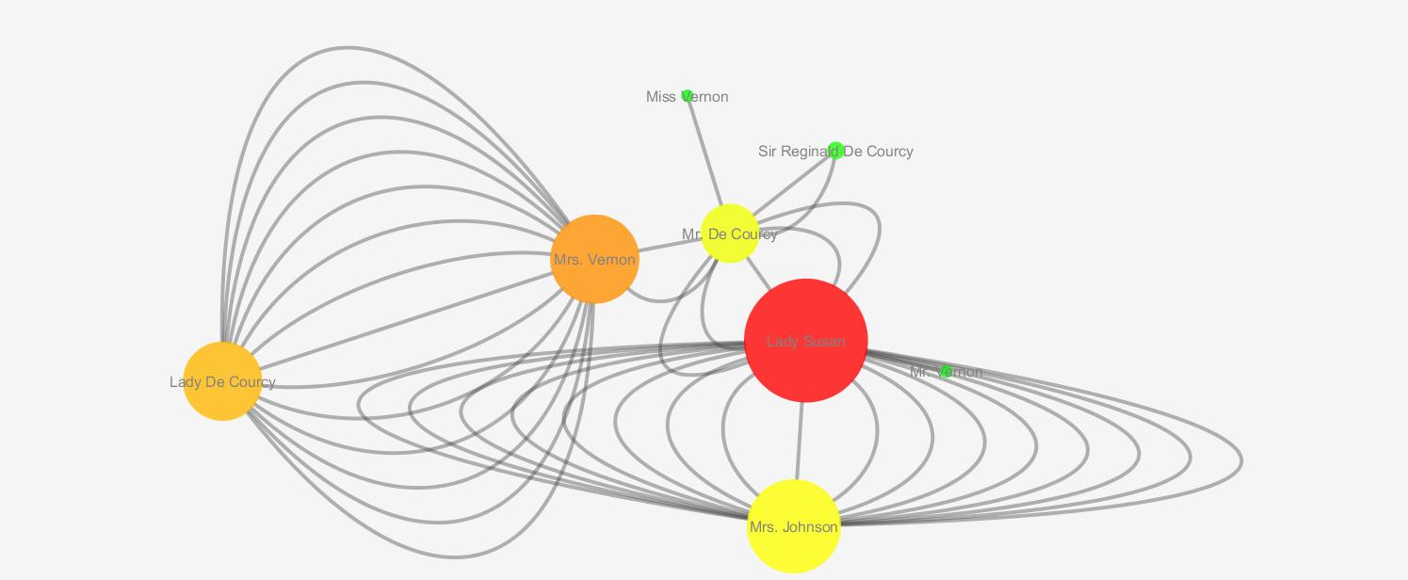
Lady Susan Network

Slide 18
Conclusions?
When you view literary data as network graph, what observations and insights do you obtain that a table would not help you make, or not as quickly?

